Slide 1
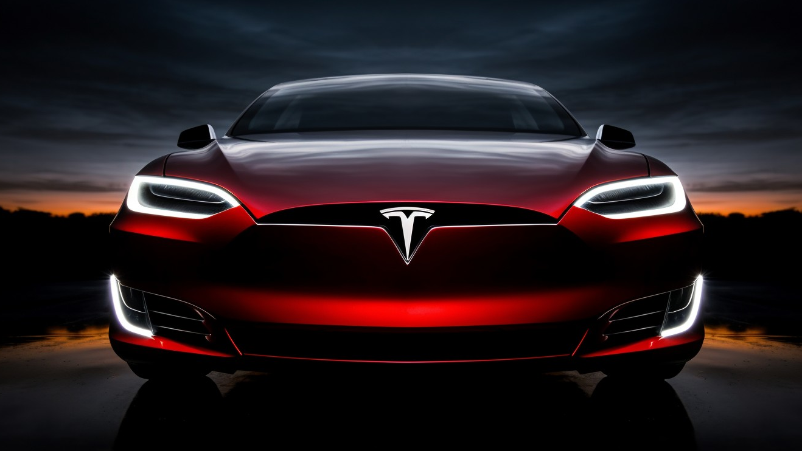
Tesla, Inc Stock Forecasting
By Ryan Martin

Slide 2

Problem Statement
How can we enhance the predictability and understanding of Tesla, Inc.'s public stock, addressing concerns about its perceived overpricing and volatility? The goal is to develop strategies for minimizing daily closing price fluctuations, optimizing moving averages, exploring time series patterns, and conducting comprehensive volatility analysis in the next quarter's earnings.
Chapter 1 : Background
Chapter 2: Pattern Recognition
Chapter 3: Pattern Optimization
Chapter 4 : Recommendations

Slide 3

Chapter 1: Background

Slide 4
Company Info
2003
Company founded
1.8M
Customer Purchases
15%
Average Annual Growth Rate
80%
EV market share
31st
S&P 500 Rank
40+
Nation Presence

Slide 5
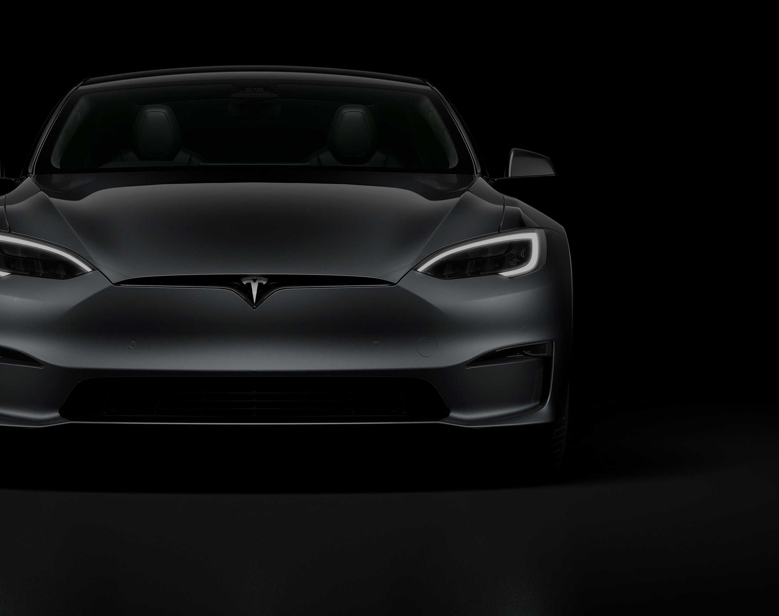
Chapter 2: Pattern Recognition

Slide 6
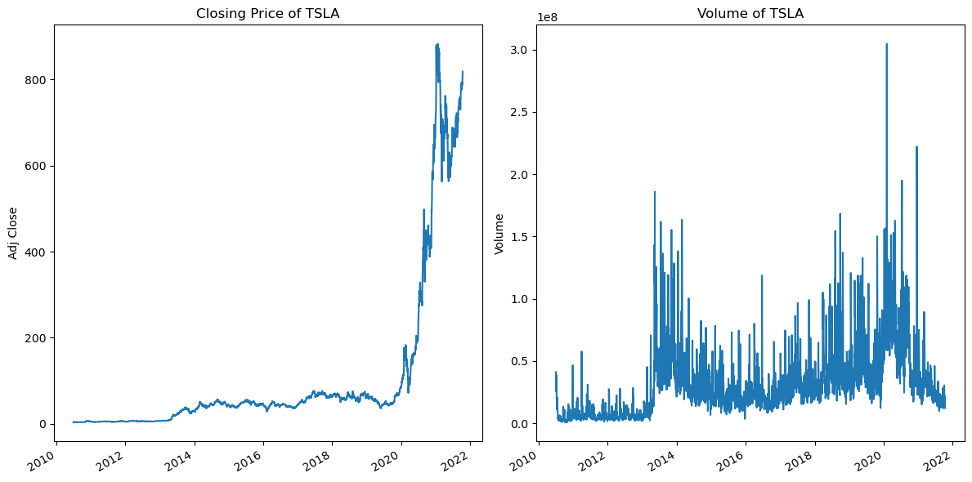
Understanding Price vs Volume

Slide 7
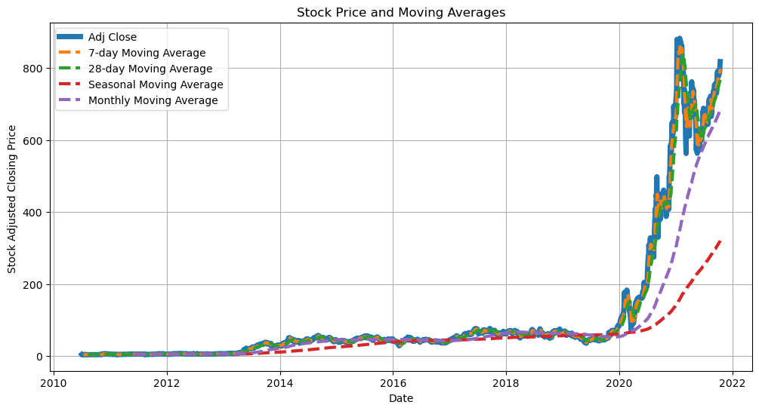
Understanding Volatility of Stock

Slide 8
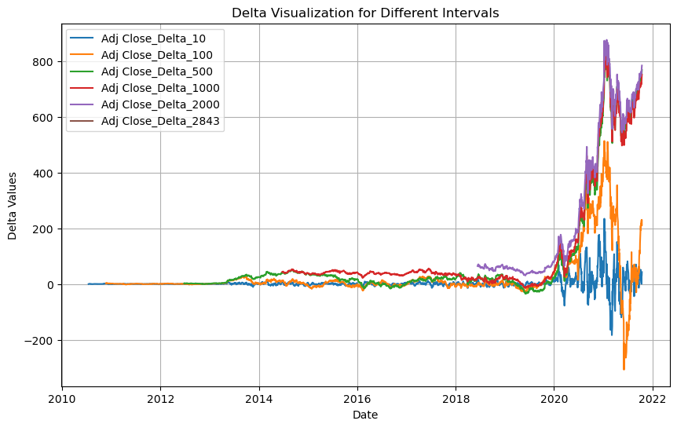
Understanding Stock Price Changes Over Time

Slide 9

Chapter 3: Pattern Optimization

Slide 10
21.31
1725.26
Best Machine Learning Model
Long Short-Term Memory Network
Model
GARCH
Root Mean Squared Error
Root Mean Squared Error
Performance Metric
Result
~1725 Units
~ 21.31 Units

Slide 11
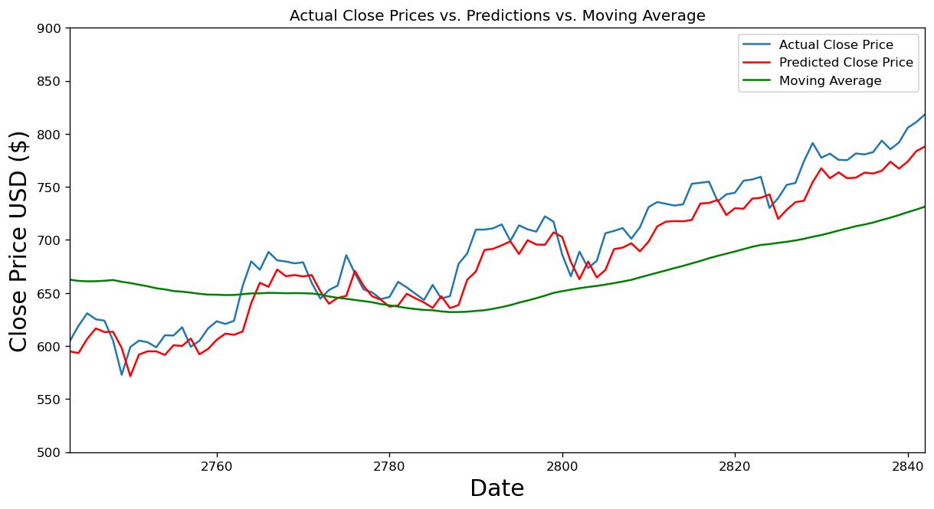
Model Performance

Slide 12

Final Chapter

Slide 13
Recommendations
Optimize Pattern Recognition
Explore External Factors
continuous monitoring & adjustment
Target
Specific Solutions
Utilize
LSTM Model
Macro-
economics
Up-to-date
information

Slide 14
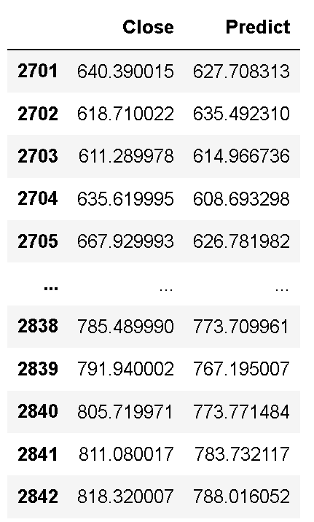
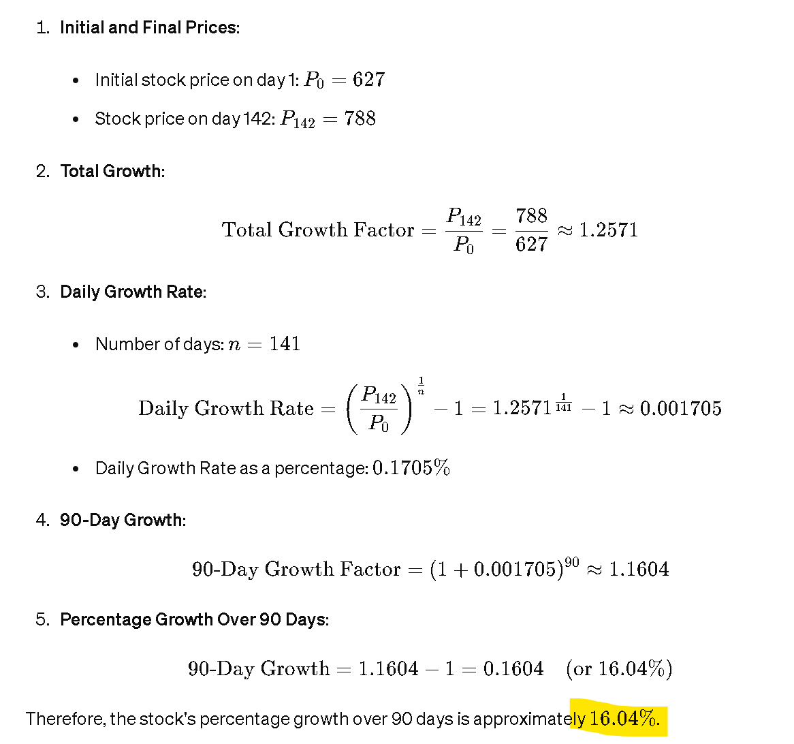
Potential Next Quarters Earnings

Slide 15
THANK YOU

